Slide 1


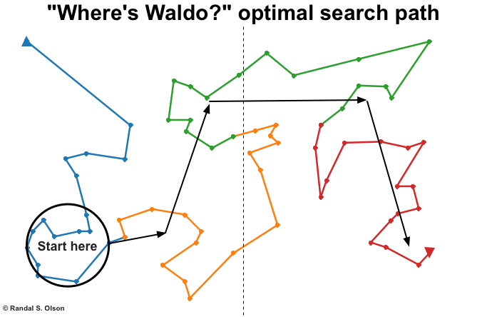
Optimal Algorithm For Finding Waldo…
UC Berkeley EECS Sr Lecturer SOE Dan Garcia
The Beauty and Joy of Computing Lecture #6 Algorithms
A researcher used a genetic algorithm – one that “evolves” over different generations, and competes against a metric of success (here, distance the eye has to travel) to find the optimal search path for finding Waldo.
www.randalolson.com/2015/02/03/heres-waldo-computing-the-optimal-search-strategy-for-finding-waldo/

Slide 2
Algorithms: Definitions

Slide 3


(AP) Computer Science Principles
7 Big Ideas
Creativity
Abstraction
Data and Information
Algorithms
Programming
The Internet
Global Impact

Slide 4
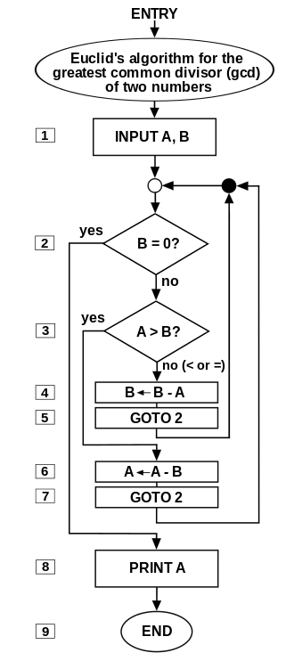
Algorithm: Definition
en.wikipedia.org/wiki/Algorithm
“Algorithms are precise sequences of instructions for processes that can be executed by a computer and are implemented using programming languages.”
The concept of algorithms, however, is far older than computers.
Euclid’s GCD Algorithm (Wikipedia, Somepics)

Slide 5

Early Algorithms
Dances, ceremonies, recipes, and building instructions are all conceptually similar to algorithms.
Babylonians defined some fundamental mathematical procedures ~3,600 years ago.
Genes contain algorithms!
Woman Basket Weaving (Wikipedia, Public Domain)

Slide 6
Algorithms You've Seen in BJC so far
Length of word
Whether a word appears in a list
Interact with the user (ask)
Word Comparisons (You wrote one for HW1!)
Sort a List (see lab!)

Slide 7
Algorithms You May Already Know
Luhn algorithm Credit card number validation | Deflate Lossless data compression
PageRank Google’s way to measure web page “reputation” | EdgeRank Facebook’s way to determine news feed sort

Slide 8
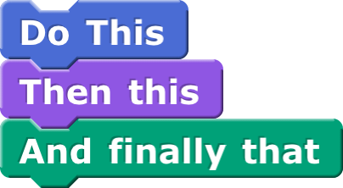
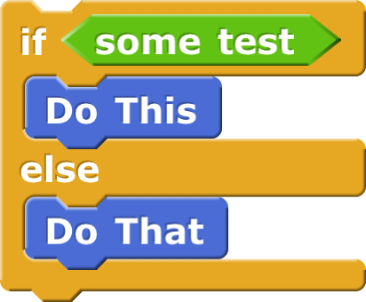
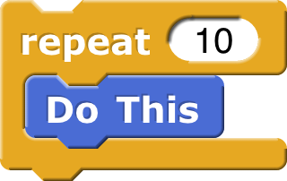

Building Blocks of Algorithms
Sequencing Application of each step of an algorithm in order given | Selection Use of Boolean condition to select which of two parts to do
Iteration Repetition algorithm part # times or until condition met | Recursion The overall algorithm calls itself to help solve the problem on smaller parts,combine result. (we’ll see later)
Every algorithm can be constructed using only Sequencing, Selection, & Iteration!
☑

Slide 9
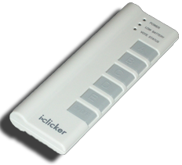
(Cal) Which of the following is false?
Algorithms can be worth billions of $
Paul Revere practiced selection
You learned your first algorithm before you could speak
Proving algorithms are correct is easy
Algorithms can adapt, like a living thing

Slide 10
Algorithms: Properties, Expressing

Slide 11
Properties of Algorithms
Algorithms can be combined to make new algorithms.
Using existing correct algorithms as building blocks for constructing a new algorithm helps ensure the new algorithm is correct.
Knowledge of standard algorithms can help in constructing new algorithms
Different algorithms can be developed to solve the same problem.
Developing a new algorithm to solve a problem can yield insight into the problem

Slide 12
How to Express Algorithms…
A programmer’s spouse says: “Run to the store and pick up a loaf of bread. If they have eggs, get a dozen.” The programmer comes home with 12 loaves of bread.
Algorithms need to be expressed in a context-free, unambiguous way for all participants!

Slide 13
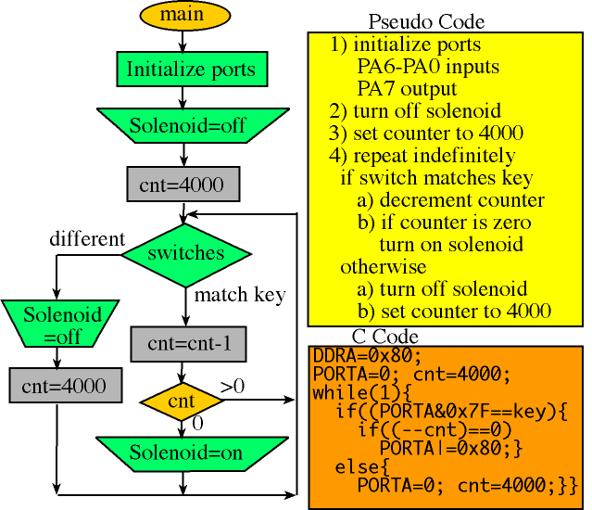
Languages for Algorithms
Natural Language, Pseudo Code
For Humans to understand
Visual & Text-based Programming Languages
Can be run on a computer
…or in any other information conveying way!
Notes:
Block diagrams: Yet another way.

Slide 14

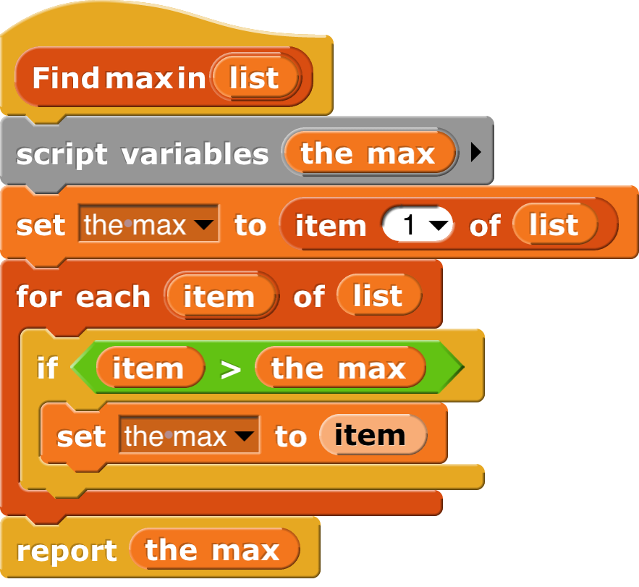
Algorithms vs. Functions & Procedures
Algorithms are conceptual definitions of how to accomplish a task and are language agnostic, usually written in pseudo-code.
Find max value in list
Set (a temporary variable) the max as the first element
Go through every element, compare to max, and if it’s bigger, replace the max
Return the max
A function or procedure is an implementation of an algorithm, in a particular language.
Find max value in list
Notes:
Function := pure def of a function (no state, no side effects)
Procedure := a block, like a function, but may have a state or side effects
===========
POINT OUT YOU CANT DRAG VARIABLES IN A SET BLOCK

Slide 15
Which Language to Choose?
Different languages are better suited for expressing different algorithms
Some programming languages are designed for specific domains and are better for expressing algorithms in those domains
The language used to express an algorithm can affect characteristics such as clarity or readability but not whether an algorithmic solution exists
Clarity and readability are important considerations when expressing an algorithm in a language.

Slide 16
Programming Languages
C/C++ Good for programming that is close to hardware | Java/C# Portable code
Python/Perl/TclTK Fast to write and portable | Scratch/Snap! Good for teaching programming concepts
Nearly all programming languages are equivalent in terms of being able to express any algorithm!
☑
Notes:
Talk about programming languages and history.

Slide 17

(Cal) Of 4 paradigms, what’s the most powerful?
Functional
Imperative
OOP
Declarative
All equally powerful

Slide 18
Algorithms: Turing Completeness

Slide 19
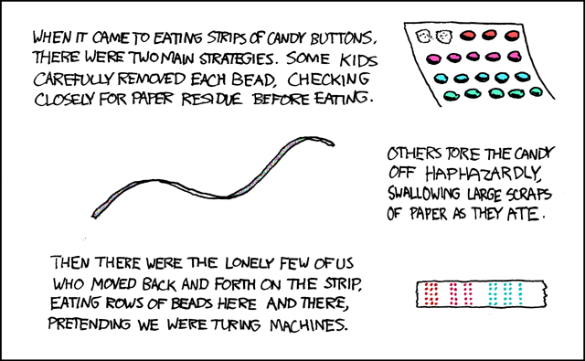
Turing Completeness
en.wikipedia.org/wiki/Turing_completeness ironphoenix.org/tril/tm/
A Turing Machine has an infinite tape of 1s and 0s and instructions that say whether to move the tape left, right, read, or write it
Can simulate any computer algorithm!
A Universal Turing Machine is one that can simulate a Turing machine on any input
A language is considered Turing Complete if it can simulate a Universal Turing Machine
A way to decide that one programming language or paradigm is just as powerful as another
Turing Machine by Tom Dunne
Xkcd comic “Candy Button Paper”

Slide 20
Summary
The concept of an algorithm has been around forever, and is an integral topic in CS.
Algorithms are well-defined procedures that can take inputs and produce output. Programming languages help us express them.
We're constantly dealing with trade-offs when selecting / building algorithms.
Each paradigm / language has its unique benefits
All Turing complete languages are equally powerful
Paradigms vary in efficiency, scalability, overhead, fun, “how” vs “what”, …
Notes:
IF TIME GO BACK TO THE LAB EXAMPLE.

